Slide 1
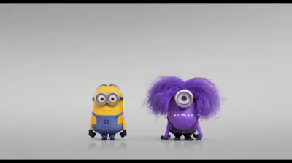

Slide 2
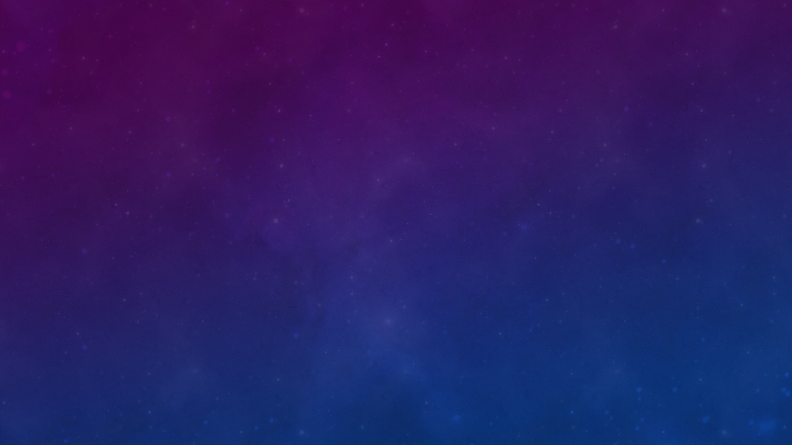
Purple
Justin Prohaska
Jael colima

Slide 3

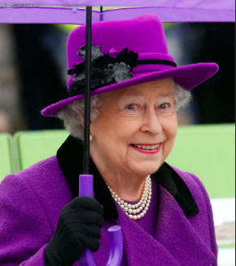
The general meaning of purple
Often times purple is associated with luxury, royalty, power, wisdom, creativity, and magic.
Also is associated with spirituality

Slide 4
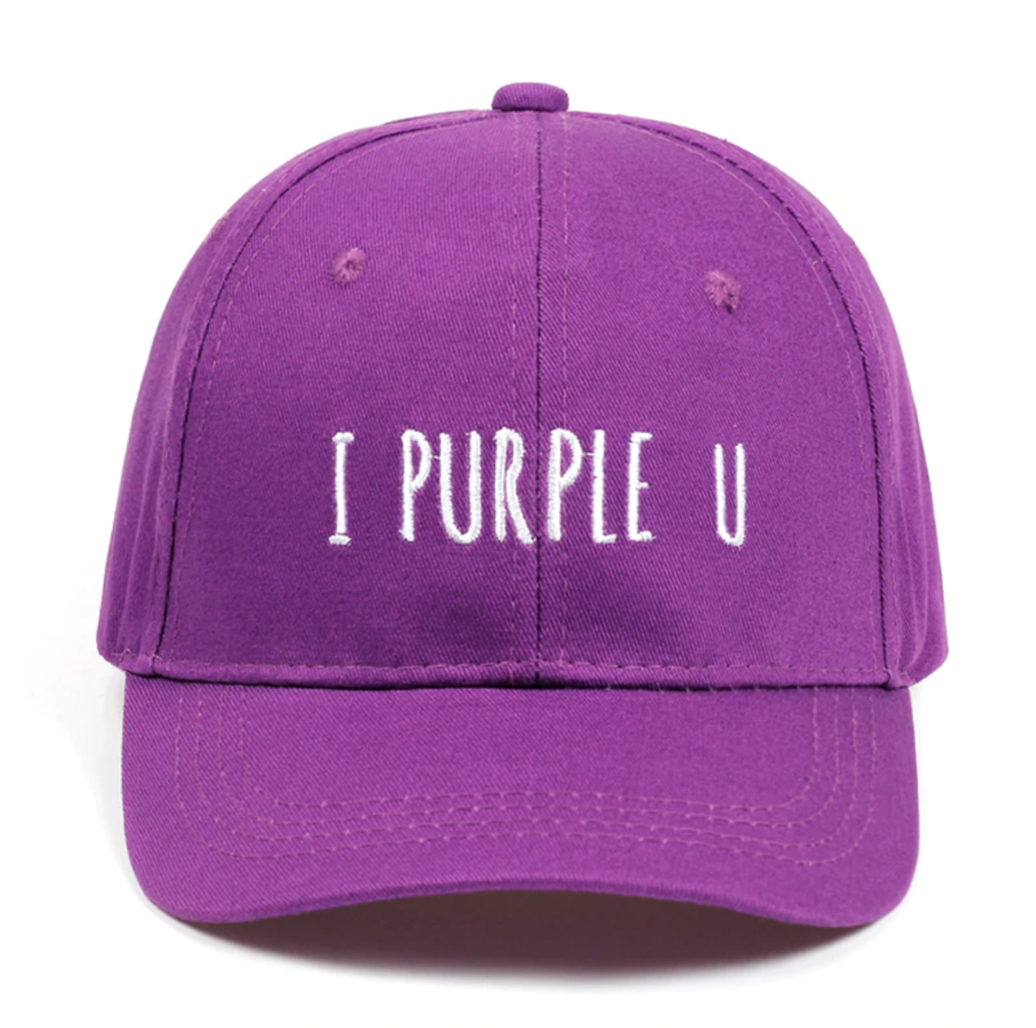
Purple positives
Purple can have calming effects over the mind and nerves, it can be uplifting and can trigger creativity.. So, from these points of view, you can have purple in any room of your house
It is the color of imagination and spirituality. Nature doesn’t have so many purple representatives, flowers bearing this color are scarce, being considered rare and delicate

Slide 5
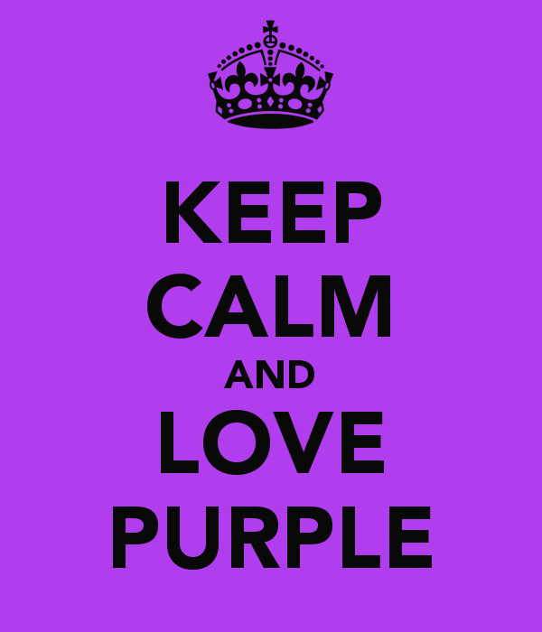
Purple positives
The color also means passion, vitality, and fulfillment.
Light purple has a feminine energy
light purple goes for feminine energy, romantic or nostalgic feelings

Slide 6
Purple negatives
Dark purple is said to represent sadness and frustration. Be careful on how much you surround yourself with this color
Too much purple can make you irritable and arrogant, even impatient with the people around you.
Too less of this color takes you to the other side, to experience apathy and negative feelings.
dark purple can be associated with sadness and frustration

Slide 7
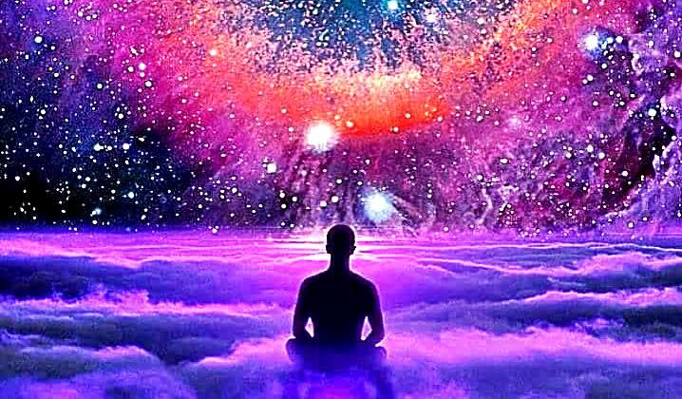
Religious and cultural differences
If you are a Christian, you may know that purple is the color of pride.
Catholic priests wear clothing with this color which reflects sorrow and suffering.
In the Chakra colors, purple is the Crown Chakra. It means it governess the mind, the nervous system, and brain.
If you are a student or passing through a difficult period, a crystal therapy with purple gems can help you deal with the situation much easier.
In Thailand purple is used during periods of mourning.

Slide 8

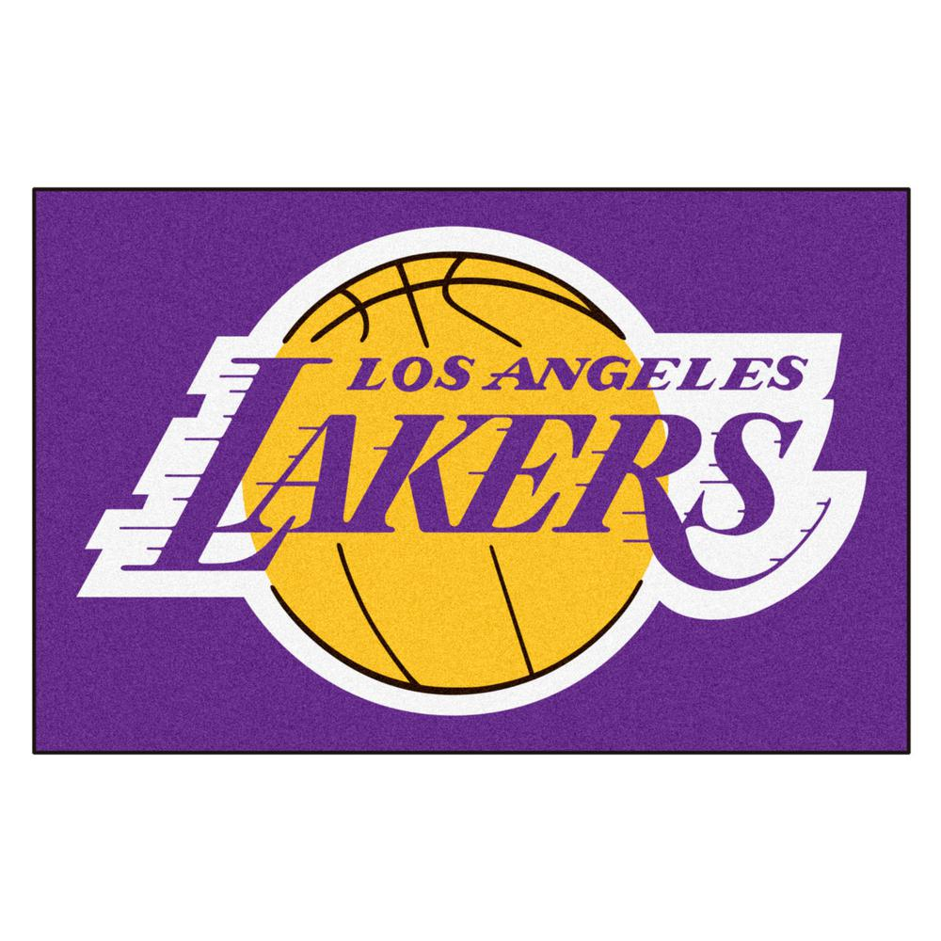
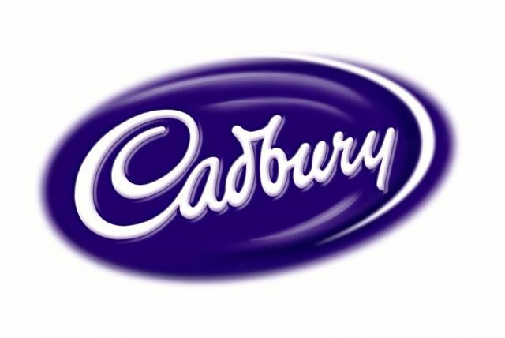




Brands have different reasons to use the color purple, mainly due to the universal meanings that it portrays: mystery, regality, sensuality, power, luxury, boldness, and even sentimentality.

Slide 9
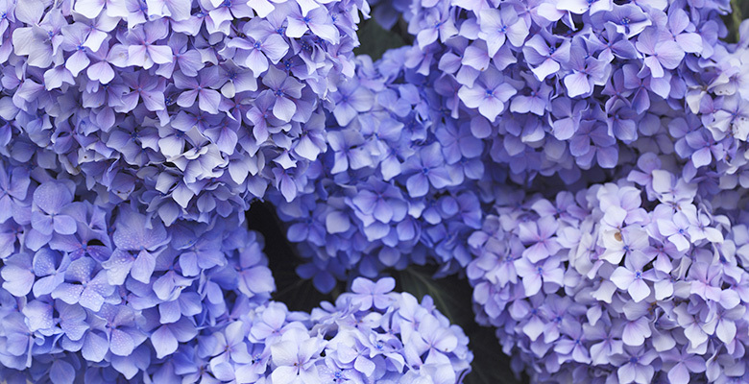
Purple Designs for web.
Web design makes use of this purple power for creating designs with a huge engaging potential, and driving people in. Purple designs are always extravagant, creative, and sophisticated. Purple is a sure-fire choice for:
luxury look
premium quality services
beauty products
Spiritual sites

Slide 10
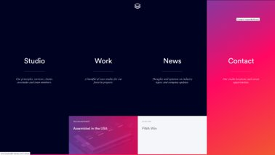

https://stablewp.com/​
http://www.impossible-bureau.com/

Slide 11

Interesting facts about purple:
Carrots used to be purple, now most are orange!
Porphyrophobia is fear of the color purple.
Purple Day is celebrated on March 26

Slide 12
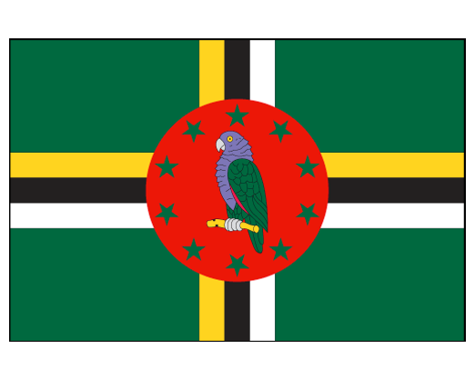
Interesting facts about purple:
There is only one nation with purple in its flag; Dominica.
There ARE words that rhyme with 'purple'.
• curple (Merriam-Webster)
• hirple (Merriam-Webster)
• turple (Urban Dictionary)
Violet, or purple, eyes are extremely rare.

Slide 13
(ノಠ益ಠ)ノ彡┻━┻
THE END

